Slide 1
PERCENTAGE

Slide 2
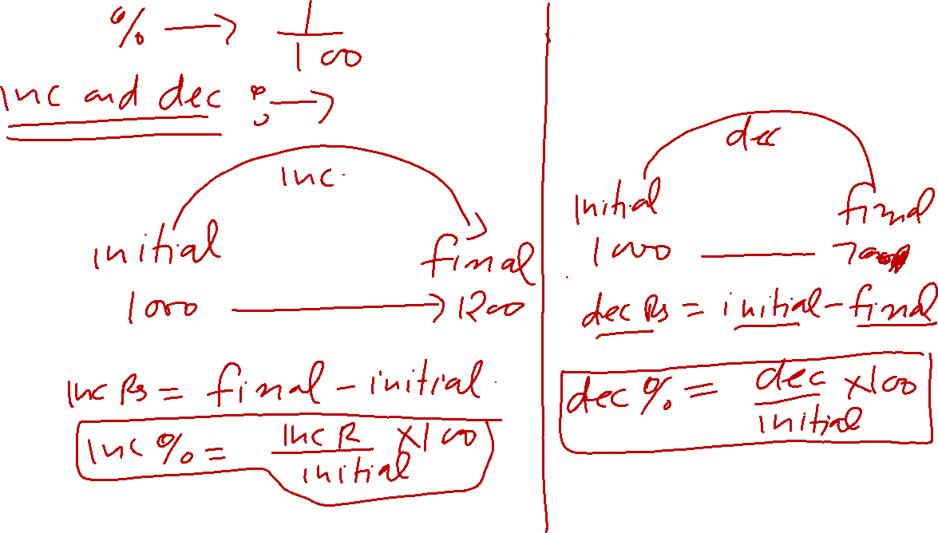

Slide 3
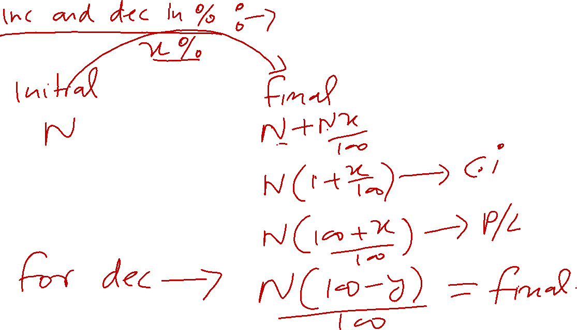

Slide 4
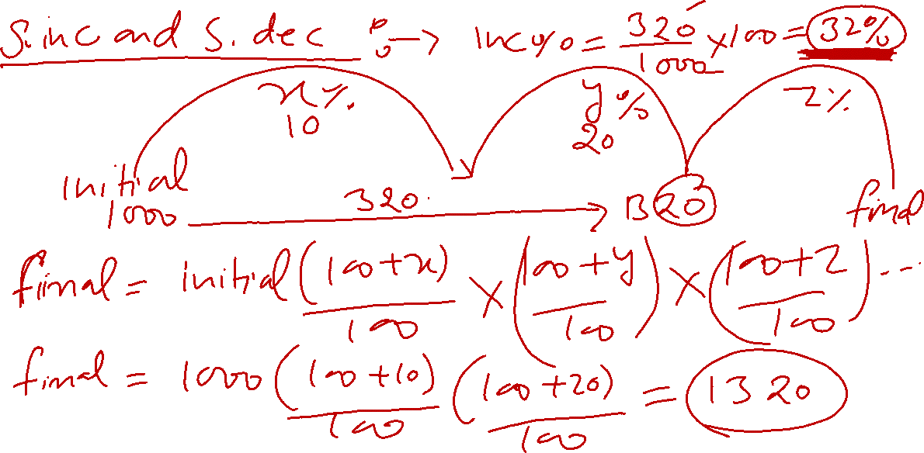

Slide 5
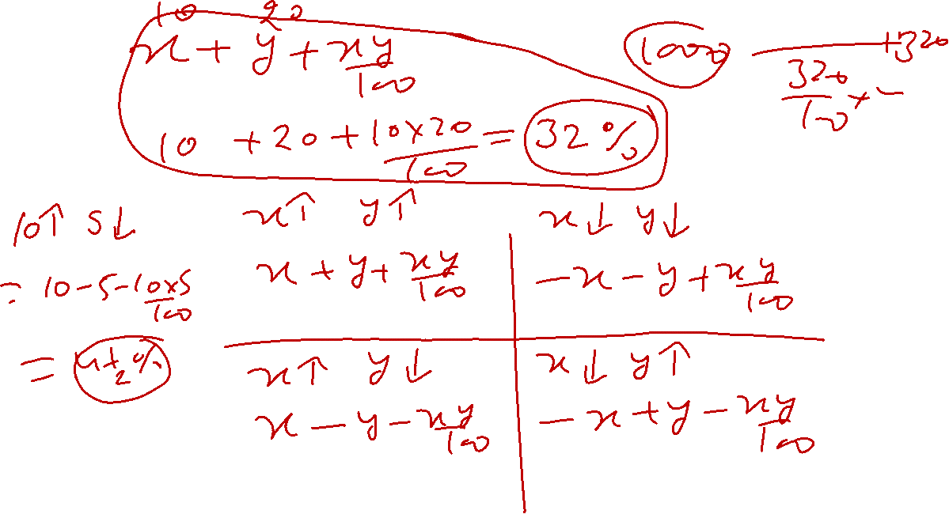

Slide 6
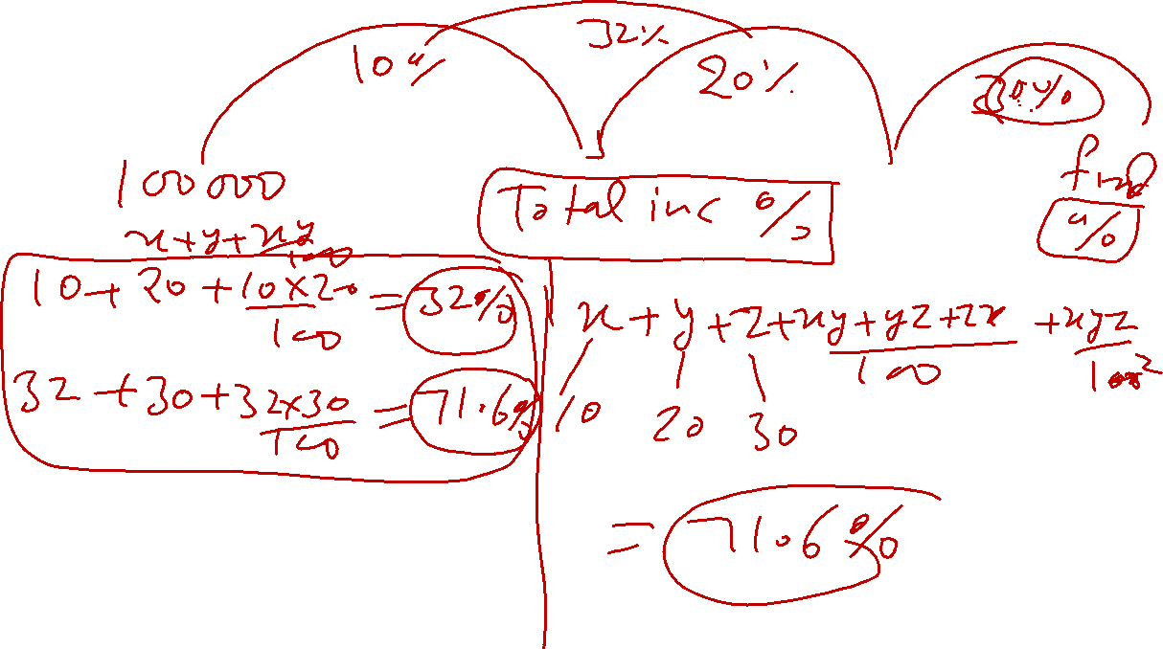

Slide 7
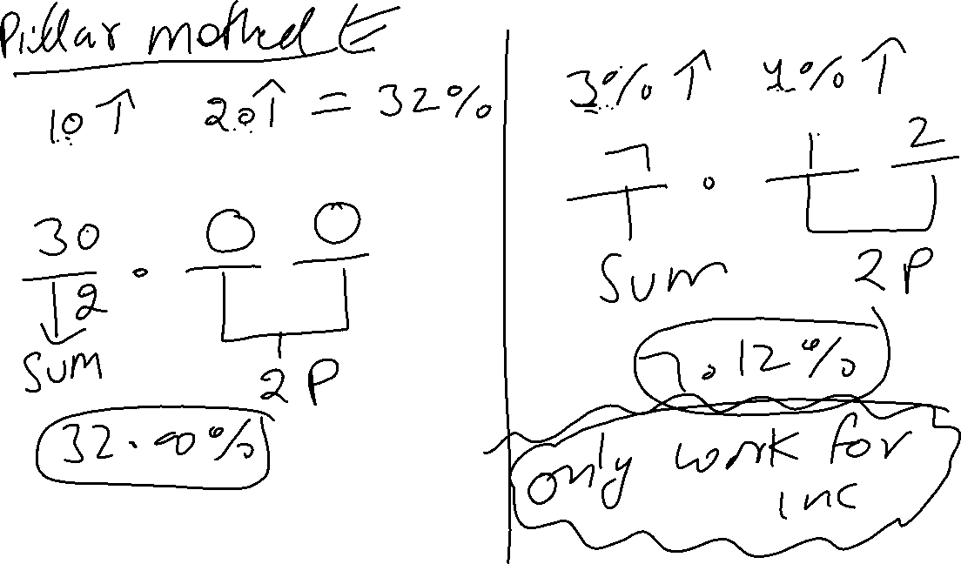

Slide 8
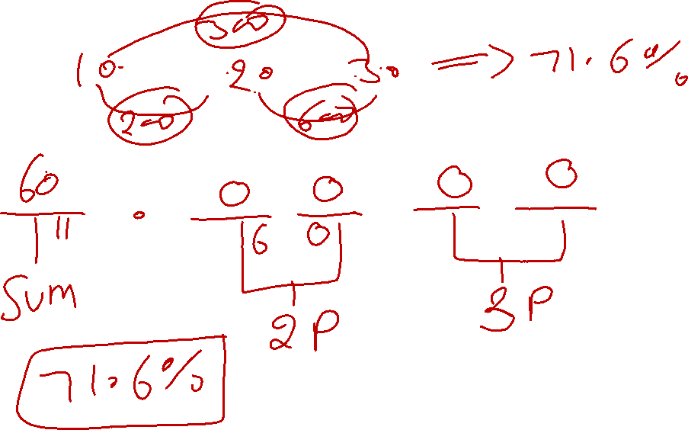

Slide 9
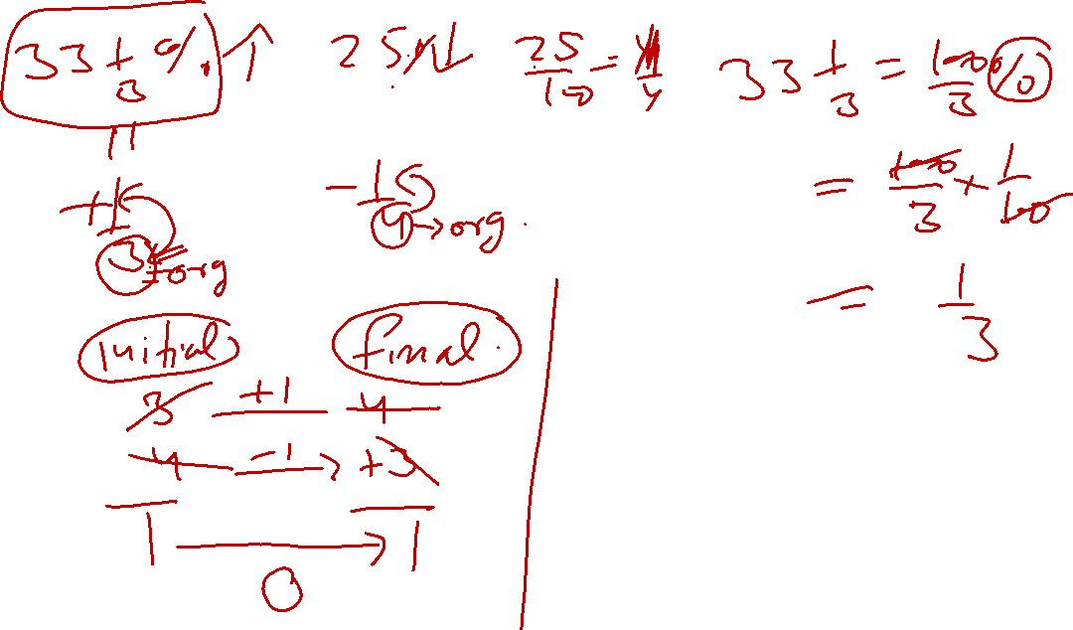

Slide 10
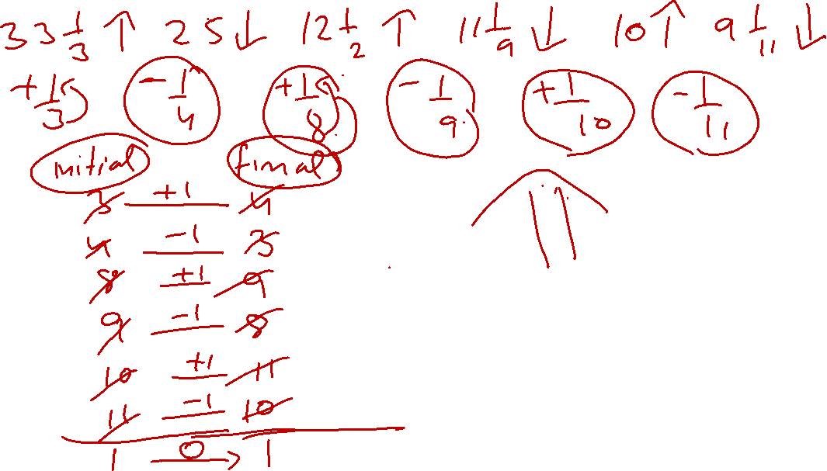

Slide 11
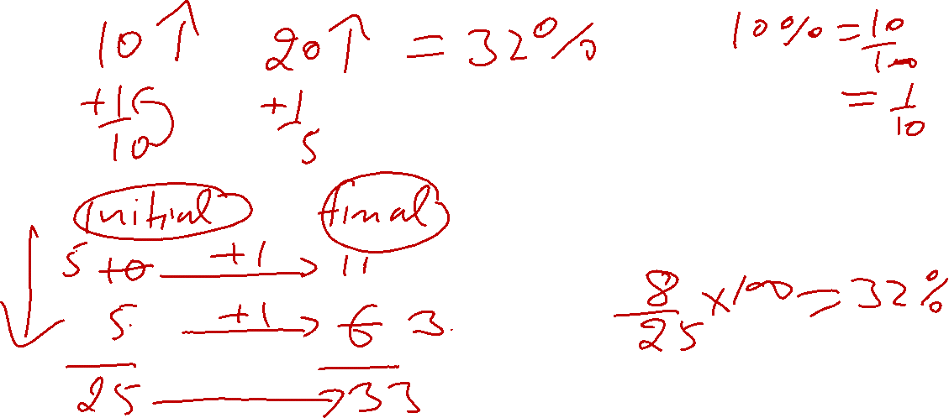

Slide 12
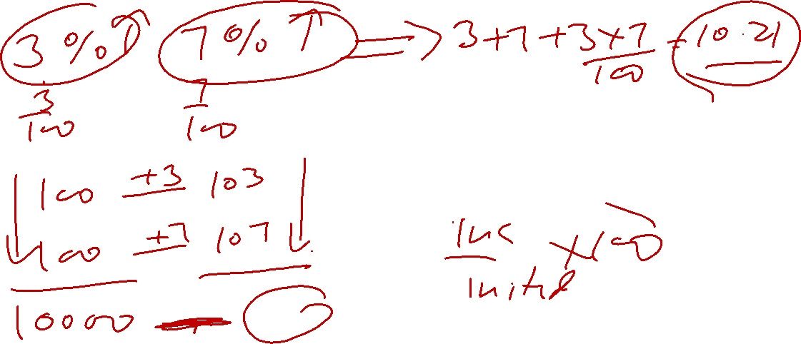

Slide 15
CONVERSION OF A FRACTION / DECIMAL INTO A PERCENT
To convert a fraction/decimal into a percentage, simply multiply the value by 100.
For example, 1/3 can be expressed in percentage terms as and the decimal 0.2 can be expressed as a percentage as 0.2 × 100 = 20%
CONVERSION OF A PERCENTAGE INTO A FRACTION
A percentage when divided by 100 is converted into a fraction/decimal. For example 20% as a fraction is
The % sign is dropped when we divide the percentage by 100. So, % =

Slide 16
Fraction | Percentage | Fraction | Percentage
1/2 | 50% | 1/6 | 16.66%
1/3 | 33.33% | 1/7 | 14.28%
1/4 | 25% | 1/8 | 12.5%
1/5 | 20% | 1/10 | 10%

Slide 17
PERCENT OF A NUMBER
To find the percent of a number, convert the percent into fraction and multiply the resultant fraction with the number.
For example, P% of a number N is =
PPRODUCT CONSISTENCY METHOD
Consider a equation where expenditure is calculated as product of price and quantity.
Expenditure (E) = Price (P) × Quantity (Q)
For example, if price gets doubled then quantity should be half to keep the expenditure constant.
Hence, we can say if product of two quantities is constant, then change in one is compensated by another quantity.

Slide 18
 | Price | Quantity | Expenditure
Inital | 4 | 5 | 4x5=20
Final | 5 | 4 | 5x4=20

Slide 19
Percentage
Q 1. What percentage is equivalent to 3/4 ?
(1) 25%
(2) 75%
(3) 50%
(4) 125%
(5) None of these

Slide 20
Percentage
Q 1. What percentage is equivalent to 3/4 ?
(1) 25%
(2) 75%
(3) 50%
(4) 125%
(5) None of these

Slide 21
Percentage
Q 2. 12(1/2) is what per cent of 16(2/3) ?
50%
(2) 25%
(3) 75%
(4) 45%
(5) None of these

Slide 22
Percentage
Q 2. 12(1/2) is what per cent of 16(2/3) ?
50%
(2) 25%
(3) 75%
(4) 45%
(5) None of these

Slide 23
Percentage
Q 3. If the price of one kg. of rice is increased by 25% , the increase is 12 Rs . Find the new price of rice per kg.
48
(2) 60
(3) 72
(4) 36
(5) None of these

Slide 24
Percentage
Q 3. If the price of one kg. of rice is increased by 25% , the increase is 12 Rs . Find the new price of rice per kg.
48
(2) 60
(3) 72
(4) 36
(5) None of these

Slide 25
Percentage
Q 4. Due to fall in manpower, the production in a factory decreases by 20%. By what per cent should the working hour be increased to restore the original production?
24%
(2) 25%
(3) 20%
(4) 35%
(5) None of these

Slide 26
Percentage
Q 4. Due to fall in manpower, the production in a factory decreases by 20%. By what per cent should the working hour be increased to restore the original production?
24%
(2) 25%
(3) 20%
(4) 35%
(5) None of these

Slide 27
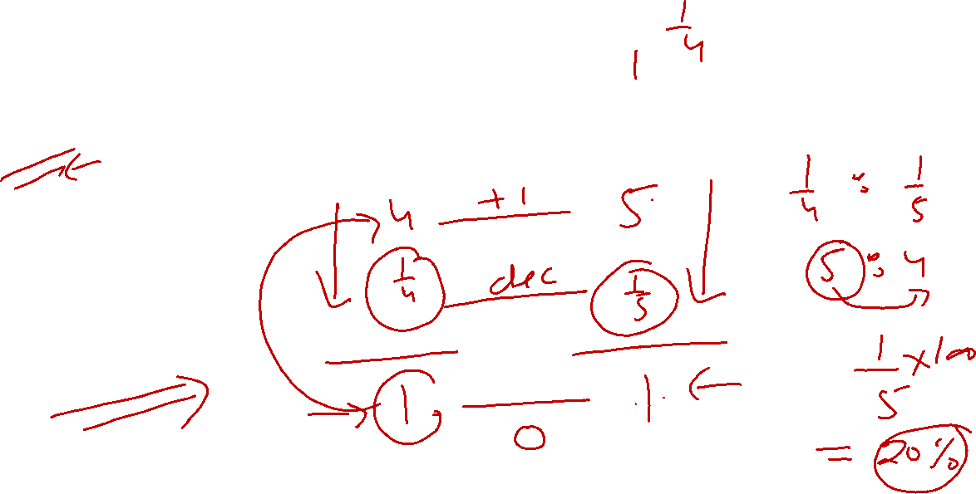
Percentage
Q 5. If the duty on imported sugar be increased by 25 per cent. By how much per cent must a man reduce his consumption of that article so as not to increase his expenditure?
20%
(2) 25%
(3) 16%
(4) 10%
(5) None of these

Slide 28
Percentage
Q 5. If the duty on imported sugar be increased by 25 per cent. By how much per cent must a man reduce his consumption of that article so as not to increase his expenditure?
(1) 20%
(2) 25%
(3) 16%
(4) 10%
(5) None of these

Slide 29
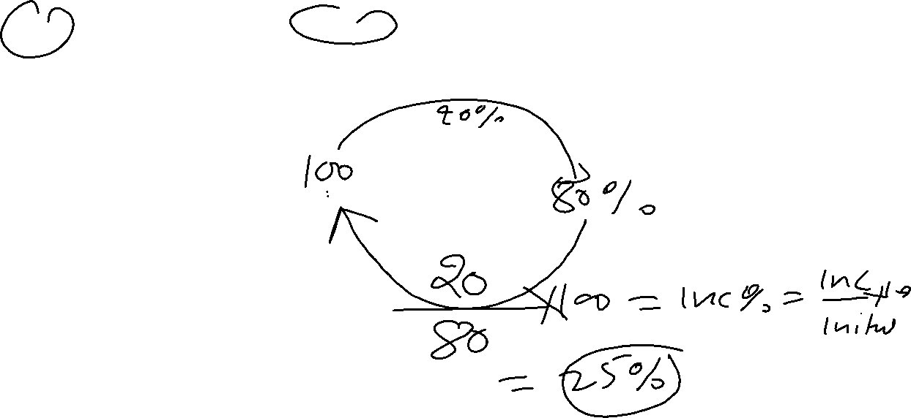
Percentage
Q 6. If the price of sugar falls down by 20%, by how much per cent must a householder increase its consumption, so as not to decrease expenditure in this item?
25%
(2) 20%
(3) 30%
(4) 15%
(5) None of these

Slide 30
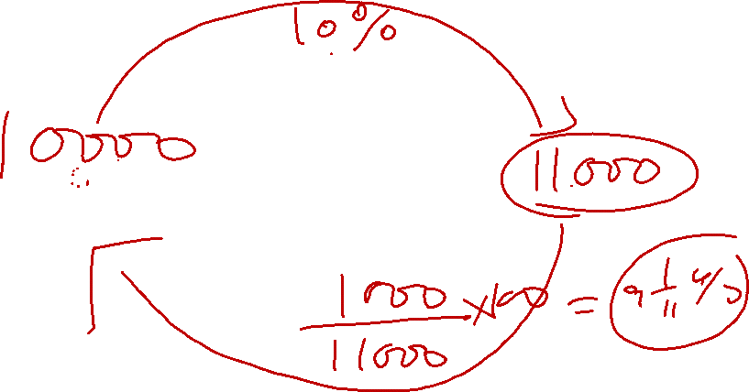
Percentage
Q 6. If the price of sugar falls down by 20%, by how much per cent must a householder increase its consumption, so as not to decrease expenditure in this item?
(1) 25%
(2) 20%
(3) 30%
(4) 15%
(5) None of these

Slide 31
Percentage
Q 7. If A’s salary is 20% more than that of B, then how much per cent is B’s salary less than that of A?
16(2/3)%
(2) 20%
(3) 40%
(4) 10%
(5) None of these

Slide 32
Percentage
Q 7. If A’s salary is 20% more than that of B, then how much per cent is B’s salary less than that of A?
(1) 16(2/3)%
(2) 20%
(3) 40%
(4) 10%
(5) None of these

Slide 33
Percentage
Q 8. A shopkeeper marks the prices of his goods at 26% higher than the original price. Due to the increase in demand, he again increases by 26%. What profit (in percent) did he get?
52%
(2) 58%
(3) 60%
(4) 58.76%
(5) None of these

Slide 34
Percentage
Q 8. A shopkeeper marks the prices of his goods at 26% higher than the original price. Due to the increase in demand, he again increases by 26%. What profit (in percent) did he get?
52%
(2) 58%
(3) 60%
(4) 58.76%
(5) None of these

Slide 35
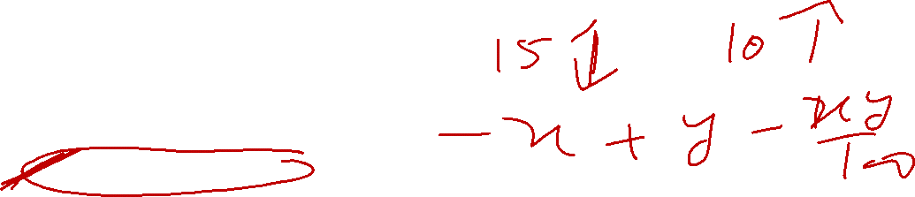
Percentage
Q 9. The tax on commodity is diminished by 15% and its consumption increases by 10%. Find the effect on revenue.
decrease of 6%
(2) decrease of 5%
(3) increase of 6.5%
(4) decrease of 6.5%
(5) None of these

Slide 36
Percentage
Q 9. The tax on commodity is diminished by 15% and its consumption increases by 10%. Find the effect on revenue.
decrease of 6%
(2) decrease of 5%
(3) increase of 6.5%
(4) decrease of 6.5%
(5) None of these

Slide 37
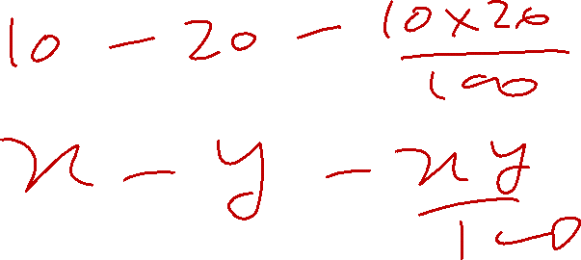
Percentage
Q 10. In measuring the sides of a rectangle, one side is taken 10% in excess and the other 20% in deficit. Find the error per cent in area calculated from the measurement.
8% excess
(2) 8% deficit
(3) 12% excess
(4) 12% deficit
(5) None of these

Slide 38
Percentage
Q 10. In measuring the sides of a rectangle, one side is taken 10% in excess and the other 20% in deficit. Find the error per cent in area calculated from the measurement.
8% excess
(2) 8% deficit
(3) 12% excess
(4) 12% deficit
(5) None of these

Slide 39

Percentage
Q 11. If one of the sides of a rectangle is increased by 20% and the other is increased by 10%, find the per cent value by which the area changes.
32%
(2) 30%
(3) 36%
(4) 34%
(5) None of these

Slide 40
Percentage
Q 11. If one of the sides of a rectangle is increased by 20% and the other is increased by 10%, find the percent value by which the area changes.
(1) 32%
(2) 30%
(3) 36%
(4) 34%
(5) None of these

Slide 41
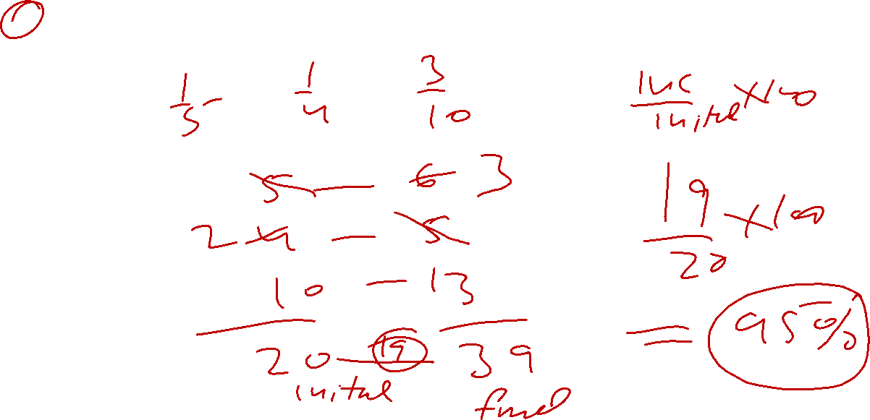
Percentage
Q12. Find a single equivalent increase, if a number is successively increased by 20%, 25% and 30%.
90%
(2) 75%
(3) 95%
(4) 85%
(5) None of these

Slide 42
Percentage
Q12. Find a single equivalent increase, if a number is successively increased by 20%, 25% and 30%.
90%
(2) 75%
(3) 95%
(4) 85%
(5) None of these

Slide 43
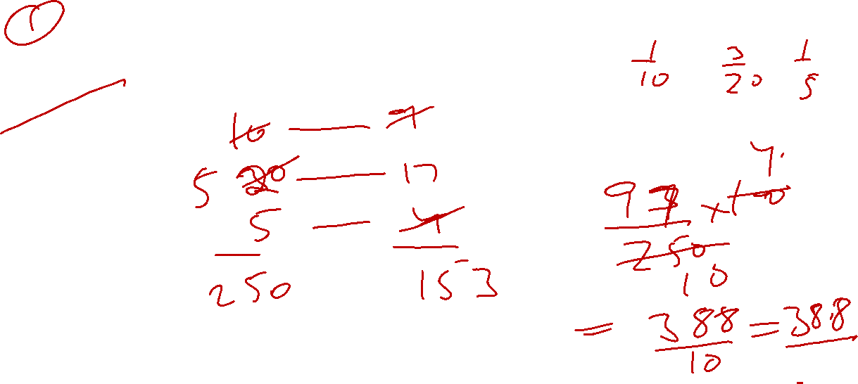
Percentage
Q13. Find a single discount equivalent to a discount series of 10%, 15% and 20%.
45%
(2) 38.8%
(3) 43.8%
(4) 39.8%
(5) None of these

Slide 44
Percentage
Q 13. Find a single discount equivalent to a discount series of 10%, 15% and 20%.
45%
(2) 38.8%
(3) 43.8%
(4) 39.8%
(5) None of these

Slide 45
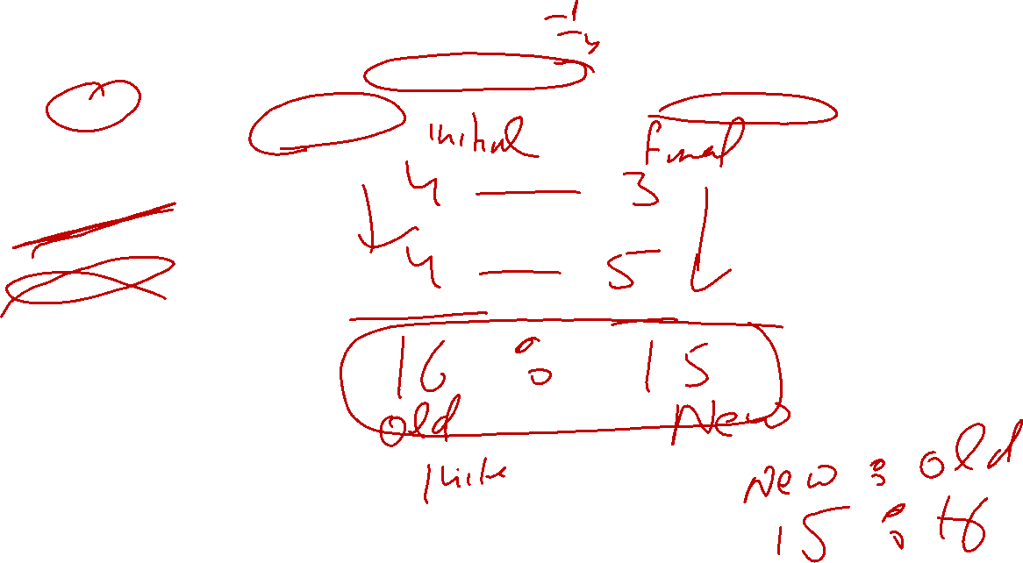
Percentage
Q 14. The price of wheat is decreased by 25% and its consumption increases by 25%. Find the new expenditure as a ratio of initial expenditure.
3 : 4
(2) 5 : 4
(3) 16 : 15
(4) 15 : 16
(5) None of these

Slide 46
Percentage
Q14. The price of wheat is decreased by 25% and its consumption increases by 25%. Find the new expenditure as a ratio of initial expenditure.
3 : 4
(2) 5 : 4
(3) 16 : 15
(4) 15 : 16
(5) None of these

Slide 47
Percentage
Q 15. In a recent survey 40% houses contained two or more people. Of those houses containing only one person 25% were having only a male. What is the percentage of all houses which contain exactly one female and no males?
75
(2) 40
(3) 15
(4) 45
(5) None of these

Slide 48
Percentage
Q 15. In a recent survey 40% houses contained two or more people. Of those houses containing only one person 25% were having only a male. What is the percentage of all houses which contain exactly one female and no males?
75
(2) 40
(3) 15
(4) 45
(5) None of these

Slide 49
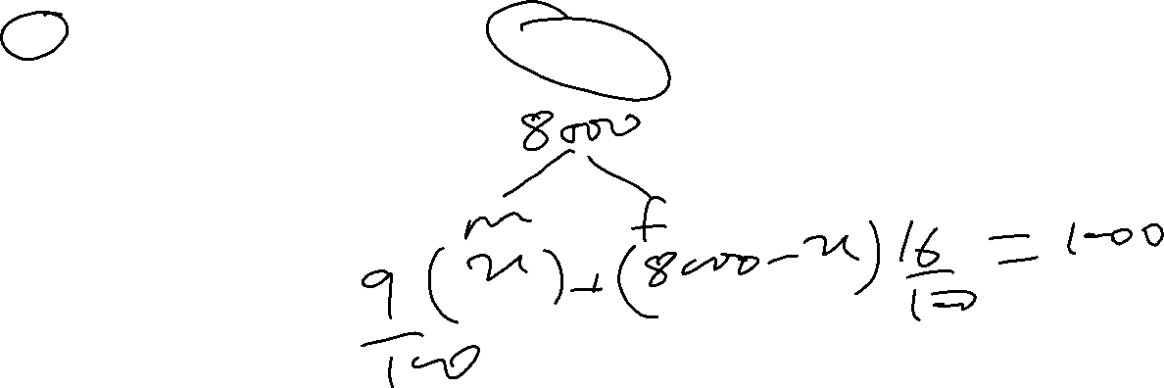
Percentage
Q 16. The population of a town is 8000. If the males increase by 9% and the females by 16%, the population will be 9000. Find the number of females in the town.
2000
(2) 4500
(3) 3000
(4) 4000
(5) None of these

Slide 50
Percentage
Q 16. The population of a town is 8000. If the males increase by 9% and the females by 16%, the population will be 9000. Find the number of females in the town.
2000
(2) 4500
(3) 3000
(4) 4000
(5) None of these

Slide 51
Percentage
Q 17. A student has to secure 15% marks to get through. If he gets 80 marks and fails by 70 marks, find the maximum marks set for the examination.
100
(2) 1000
(3) 1500
(4) 900
(5) None of these

Slide 52
Percentage
Q 17. A student has to secure 15% marks to get through. If he gets 80 marks and fails by 70 marks, find the maximum marks set for the examination.
100
(2) 1000
(3) 1500
(4) 900
(5) None of these

Slide 53
Percentage
Q 18. A candidate scores 35% and fails by 40 marks, while another candidate who scores 60% marks, gets 35 marks more than the minimum required marks to pass the examination. Find the maximum marks for the examination.
300
(2) 200
(3) 350
(4) 450
(5) None of these

Slide 54
Percentage
Q 18. A candidate scores 35% and fails by 40 marks, while another candidate who scores 60% marks, gets 35 marks more than the minimum required marks to pass the examination. Find the maximum marks for the examination.
(1) 300
(2) 200
(3) 350
(4) 450
(5) None of these

Slide 55
Percentage
Q 19. A candidate scores 46% and fails by 55 marks, while another candidate who scores 81% marks, gets 15 marks more than the minimum required marks to pass the examination. Find the maximum marks for the examination.
350
(2) 100
(3) 150
(4) 200
(5) None of these

Slide 56
Percentage
Q 19. A candidate scores 46% and fails by 55 marks, while another candidate who scores 81% marks, gets 15 marks more than the minimum required marks to pass the examination. Find the maximum marks for the examination.
350
(2) 100
(3) 150
(4) 200
(5) None of these

Slide 57
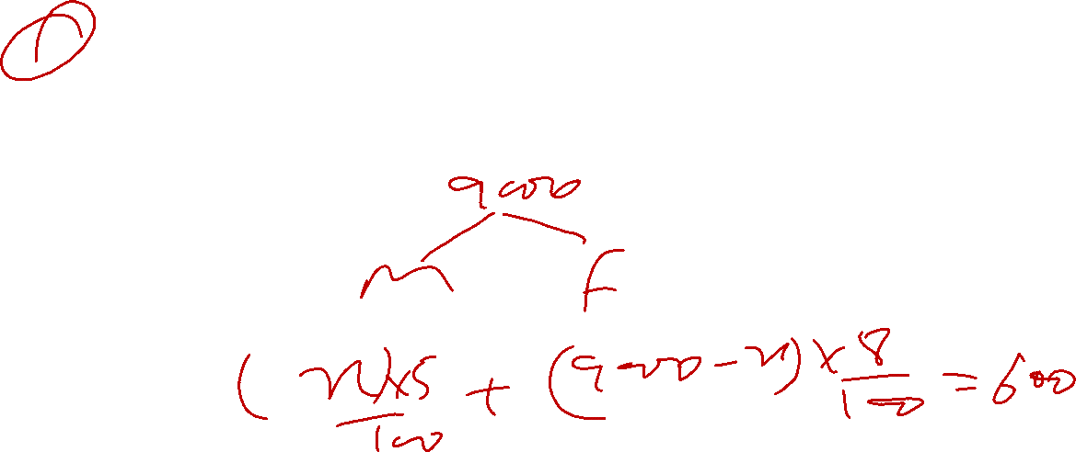
Percentage
Q 20. In a certain year, the population of a certain town wan 9000. If the next year the population of males increases by 5% and that of the females by 8% and the total population increases to 9600, then what was the ratio of population of males and females in that given year?
4 : 5
(2) 5 : 4
(3) 2 : 3
(4) Data inadequate
(5) None of these

Slide 58
Percentage
Q 20. In a certain year, the population of a certain town wan 9000. If the next year the population of males increases by 5% and that of the females by 8% and the total population increases to 9600, then what was the ratio of population of males and females in that given year?
(1) 4 : 5
(2) 5 : 4
(3) 2 : 3
(4) Data inadequate
(5) None of these

Slide 59
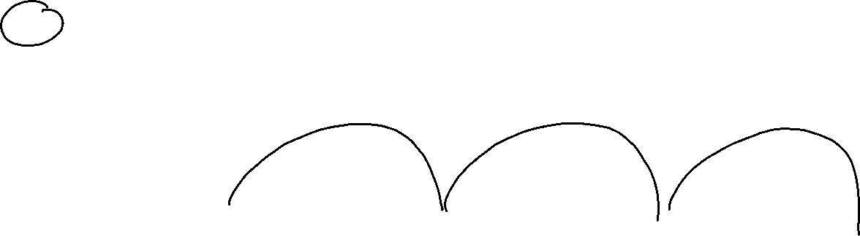
Percentage
Q 21. The population of a town is 64000. It increases by 10% during the first year. During the second year, it decreases by 25% and increased by 5% during the third year. What is the population after 3 years?
654400
(2) 56440
(3) 55450
(4) 55440
(5) None of these

Slide 60
Percentage
Q 21. The population of a town is 64000. It increases by 10% during the first year. During the second year, it decreases by 25% and increased by 5% during the third year. What is the population after 3 years?
654400
(2) 56440
(3) 55450
(4) 55440
(5) None of these

Slide 61
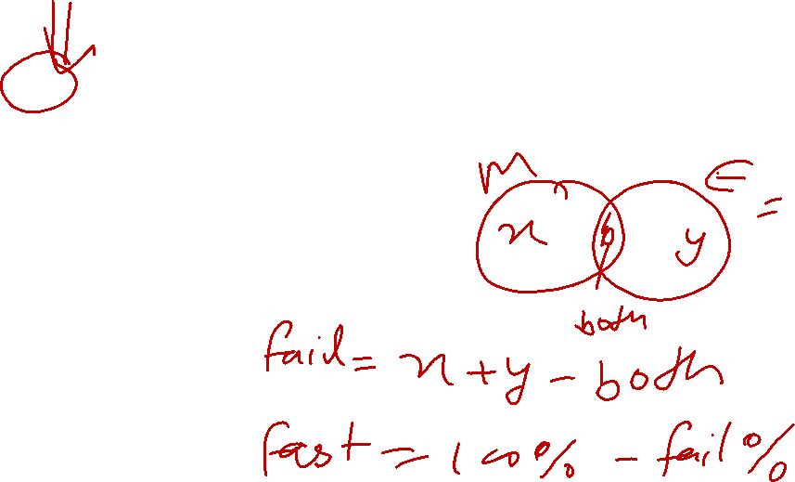
Percentage
Q 22. In an examination, 10% of the students failed in Maths, 20% failed in English and 5% failed in both. Find the percentage of students who passed in both the subjects.
75%
(2) 70%
(3) 85%
(4) 80%
(5) None of these

Slide 62
Percentage
Q 22. In an examination, 10% of the students failed in Maths, 20% failed in English and 5% failed in both. Find the percentage of students who passed in both the subjects.
(1) 75%
(2) 70%
(3) 85%
(4) 80%
(5) None of these

Slide 63
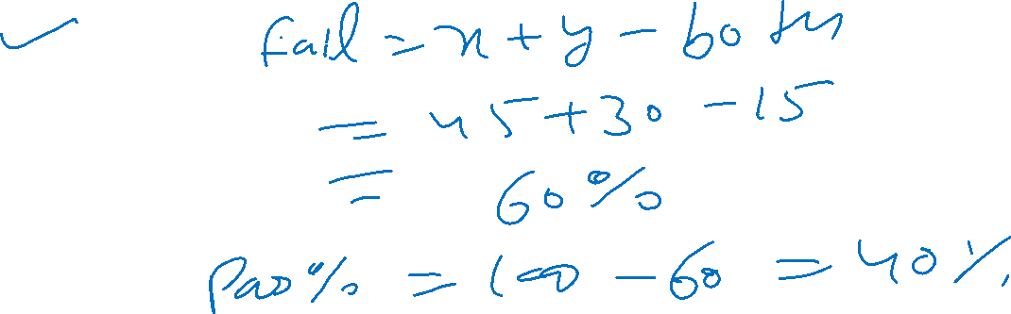
Percentage
Q 23. In an examination; 45% of the students failed in Maths, 30% failed in English and 15% failed in both. Find the percentage of students who passed in both the subjects.
70%
(2) 40%
(3) 25%
(4) 75%
(5) None of these

Slide 64
Percentage
Q 23. In an examination; 45% of the students failed in Maths, 30% failed in English and 15% failed in both. Find the percentage of students who passed in both the subjects.
70%
(2) 40%
(3) 25%
(4) 75%
(5) None of these

Slide 65
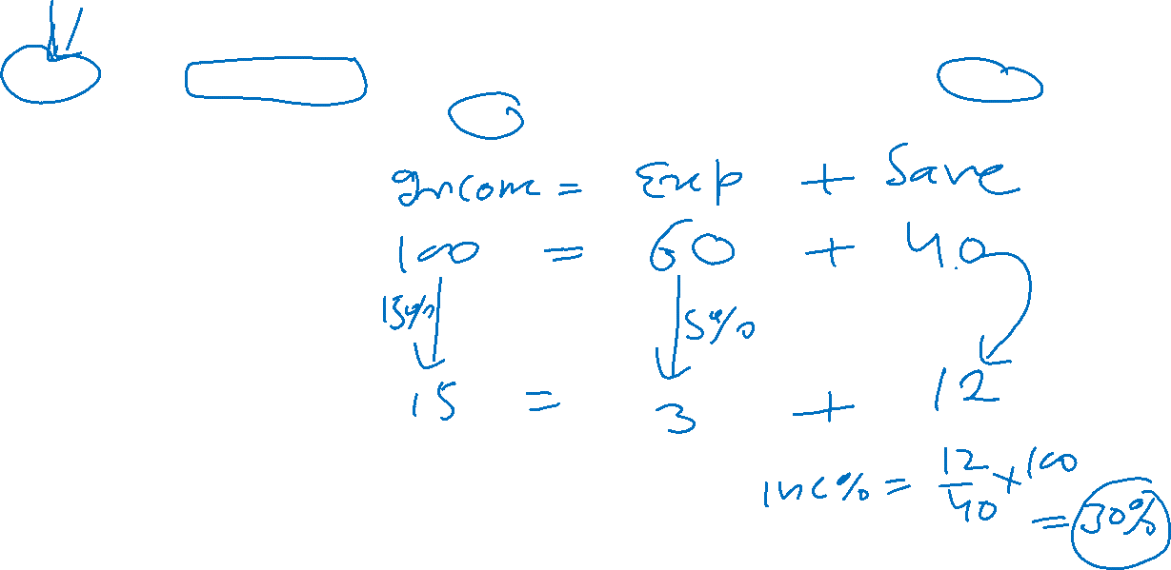
Percentage
Q 24. A man spends 60% of his income. His income increases by 15% and his expenditure also increases by 5%. Find the percentage increase in his savings.
30%
(2) 15%
(3) 20%
(4) 25%
(5) None of these

Slide 66
Percentage
Q 24. A man spends 60% of his income. His income increases by 15% and his expenditure also increases by 5%. Find the percentage increase in his savings.
(1) 30%
(2) 15%
(3) 20%
(4) 25%
(5) None of these

Slide 67
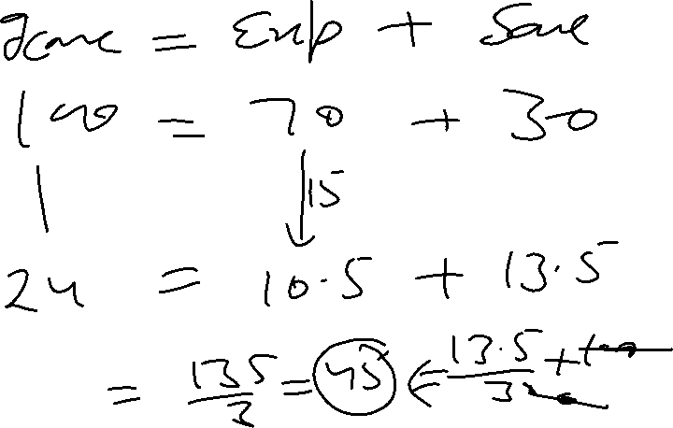
Percentage
Q 25. A man spends 70% of his income. His income increases by 24% and his expenditure also increase by 15%. Find the percentage increase in his savings.
35%
(2) 24%
(3) 45%
(4) 55%
(5) None of these

Slide 68
Percentage
Q 25. A man spends 70% of his income. His income increases by 24% and his expenditure also increase by 15%. Find the percentage increase in his savings.
35%
(2) 24%
(3) 45%
(4) 55%
(5) None of these

Slide 69
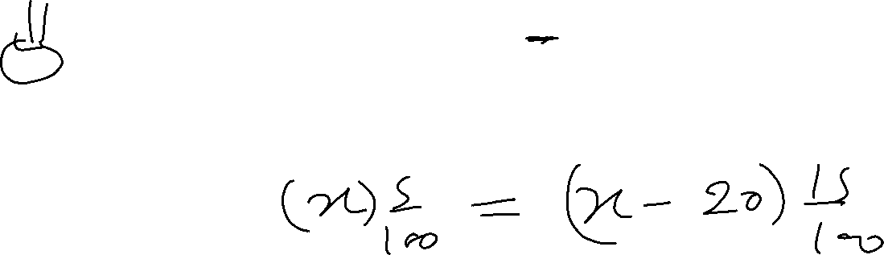
Percentage
Q 26. A solution of salt and water contains 5% salt by weight. Of it 20 kg water evaporates and the solution now contains 15% of salt. Find the original quantity of solution.
15 kg.
(2) 30 kg.
(3) 18 kg.
(4) 24 kg.
(5) None of these

Slide 70
Percentage
Q 26. A solution of salt and water contains 5% salt by weight. Of it 20 kg water evaporates and the solution now contains 15% of salt. Find the original quantity of solution.
15 kg.
(2) 30 kg.
(3) 18 kg.
(4) 24 kg.
(5) None of these

Slide 71
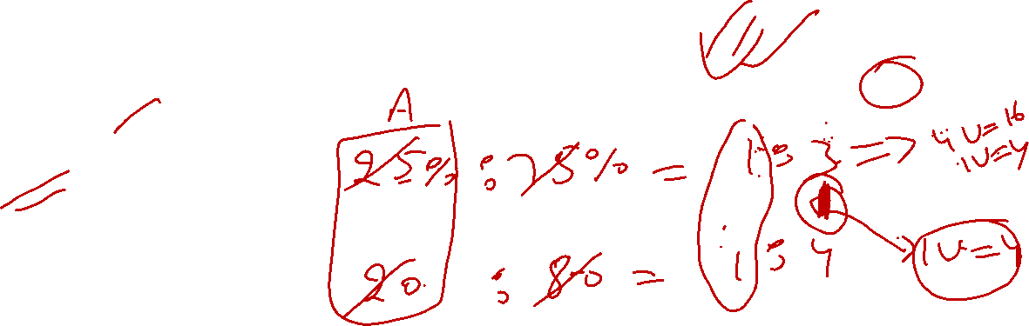
Percentage
Q 27. What quantity of water should be added to reduce 16 litres of 25% acidic liquid to 20% acidic liquid?
5 litres
(2) 4 litres
(3) 12 litres
(4) 8 litres
(5) None of these

Slide 72
Percentage
Q 27. What quantity of water should be added to reduce 16 litres of 25% acidic liquid to 20% acidic liquid?
5 litres
(2) 4 litres
(3) 12 litres
(4) 8 litres
(5) None of these

Slide 73
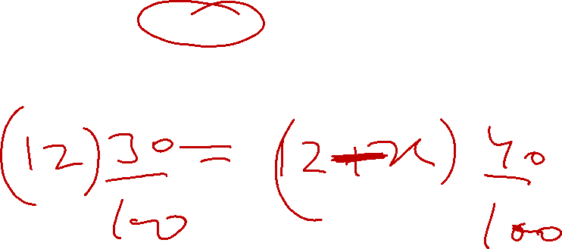
Percentage
Q 28. What quantity of water should be taken out to concentrate 12 litres of 30% acidic liquid to 40% acidic liquid.
4 litres
(2) 6 litres
(3) 3 litres
(4) 8 litres
(5) None of these

Slide 74
Percentage
Q 28. What quantity of water should be taken out to concentrate 12 litres of 30% acidic liquid to 40% acidic liquid.
4 litres
(2) 6 litres
(3) 3 litres
(4) 8 litres
(5) None of these

Slide 75

Percentage
Q 29. What quantity of water should be taken out to concentrate 21 litres of 25% acidic liquid to 35% acidic liquid.
6 litres
(2) 8.4 litres
(3) 6.4 litres
(4) 8 litres
(5) None of these

Slide 76
Percentage
Q 29. What quantity of water should be taken out to concentrate 21 litres of 25% acidic liquid to 35% acidic liquid.
(1) 6 litres
(2) 8.4 litres
(3) 6.4 litres
(4) 8 litres
(5) None of these

Slide 77
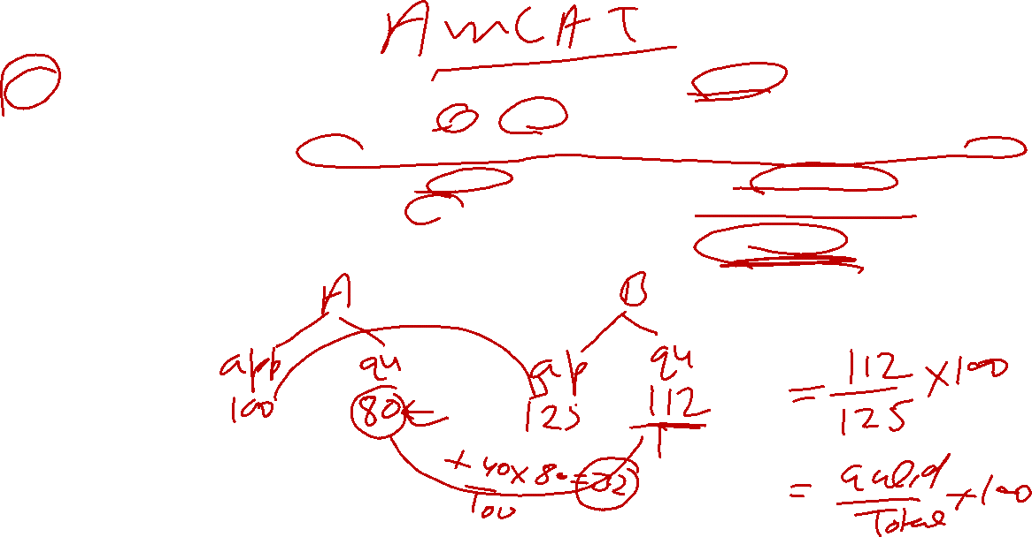
Percentage
Q 30. In an examination the percentage of students qualified to the number of students appeared from school ‘A’ is 80%. In school ‘B’ the number of students appeared is 25% more than the students appeared from school ‘A’ and the number of students qualified from school ‘B’ is 40% more than the students qualified from school ‘A’. What is the percentage of students qualified to the number of students appeared from school ‘B’?
45%
(2) 90%
(3) 89.5%
(4) 89.6%
(5) None of these

Slide 78
Percentage
Q 30. In an examination the percentage of students qualified to the number of students appeared from school ‘A’ is 80%. In school ‘B’ the number of students appeared is 25% more than the students appeared from school ‘A’ and the number of students qualified from school ‘B’ is 40% more than the students qualified from school ‘A’. What is the percentage of students qualified to the number of students appeared from school ‘B’?
45%
(2) 90%
(3) 89.5%
(4) 89.6%
(5) None of these

Slide 79
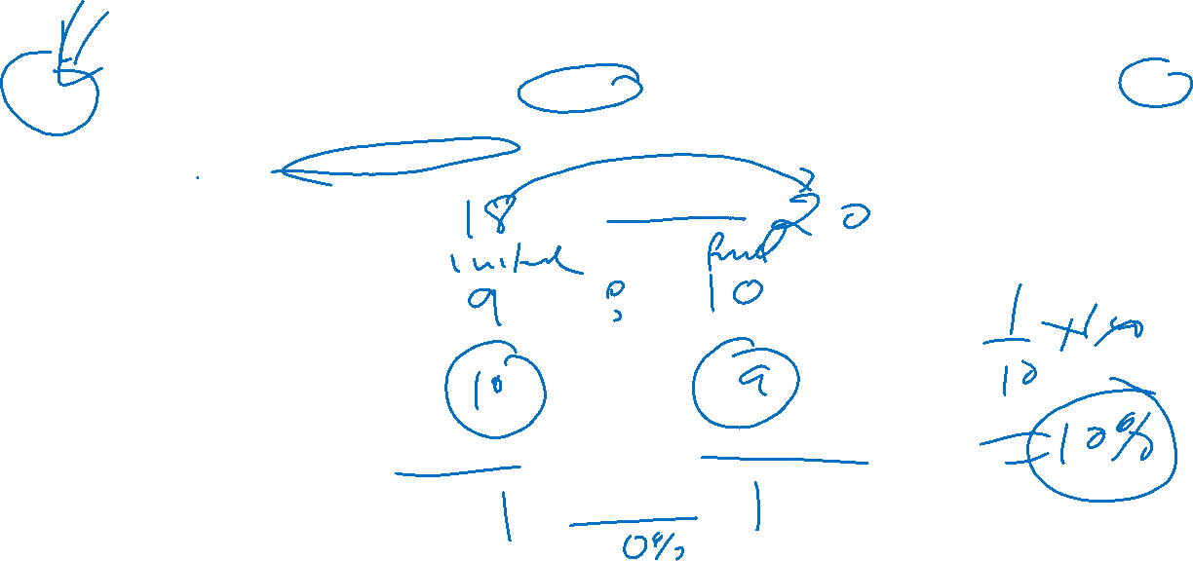
Percentage
Q 31. Rice is now being sold at Rs. 20 per kg. During last month its cost was 18 per kg. Find by how much percent a family should reduce its consumption, so as to keep the expenditure the same.
10%
(2) 20%
(3) 15%
(4) 5%
(5) None of these

Slide 80
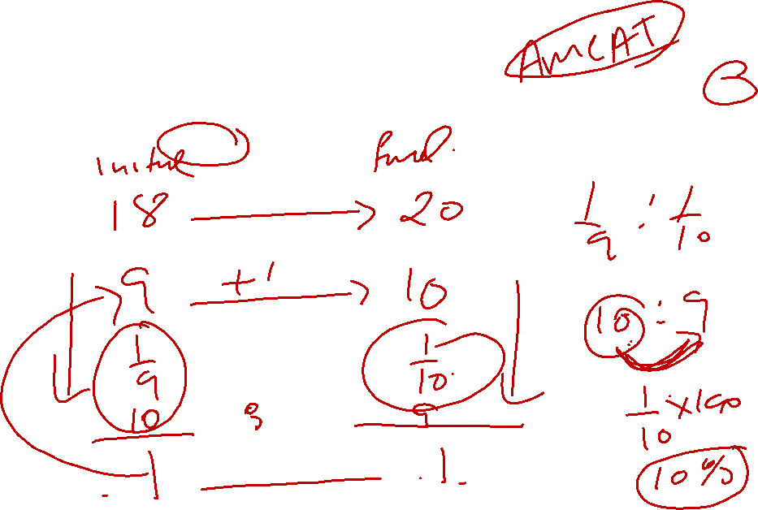
Percentage
Q 31. Rice is now being sold at Rs. 20 per kg. During last month its cost was 18 per kg. Find by how much percent a family should reduce its consumption, so as to keep the expenditure the same.
(1) 10%
(2) 20%
(3) 15%
(4) 5%
(5) None of these

Slide 81
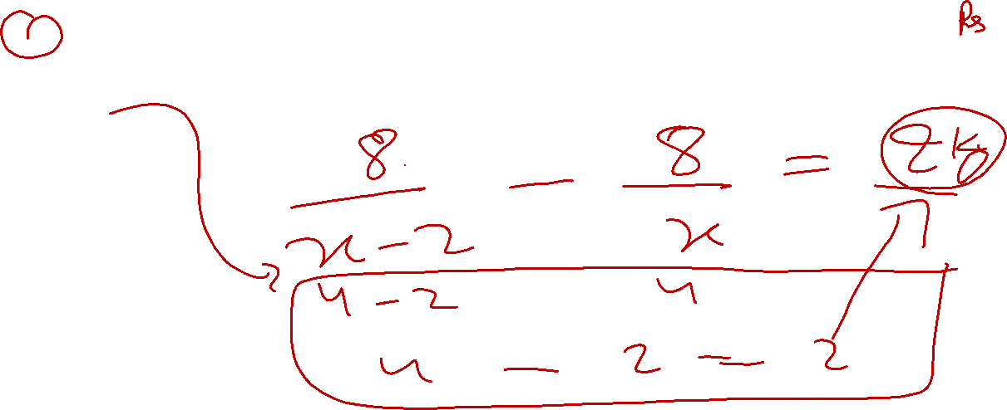
Percentage
Q 32. A reduction of 2 per kg enables a man to purchase 2 kg more tea for 8. Find the original price of tea per kg.
4 per kg.
(2) 6 per kg.
(3) 2 per kg.
(4) 3 per kg.
(5) None of these

Slide 82
Percentage
Q 32. A reduction of 2 per kg enables a man to purchase 2 kg more tea for 8. Find the original price of tea per kg.
(1) 4 per kg.
(2) 6 per kg.
(3) 2 per kg.
(4) 3 per kg.
(5) None of these

Slide 83
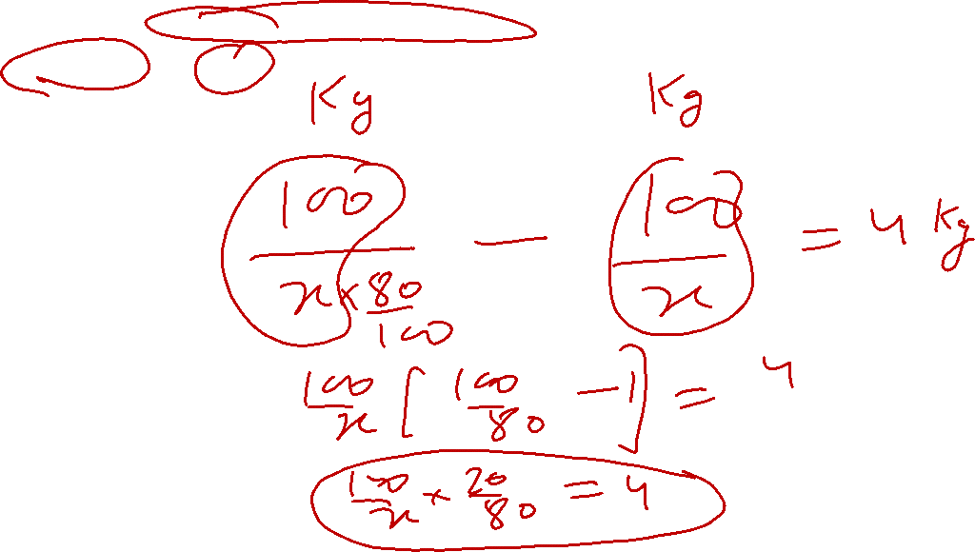
Percentage
Q 33. A reduction of 20 per cent in the price of tea would enable a purchaser to obtain 4 kg. more for 100, what is the reduced price, and original price?
6.25, 5
(2) 5, 6.25
(3) 6, 5.25
(4) 5.25, 6
(5) None of these

Slide 84
Percentage
Q 33. A reduction of 20 per cent in the price of tea would enable a purchaser to obtain 4 kg. more for 100, what is the reduced price, and original price?
6.25, 5
(2) 5, 6.25
(3) 6, 5.25
(4) 5.25, 6
(5) None of these

Slide 85
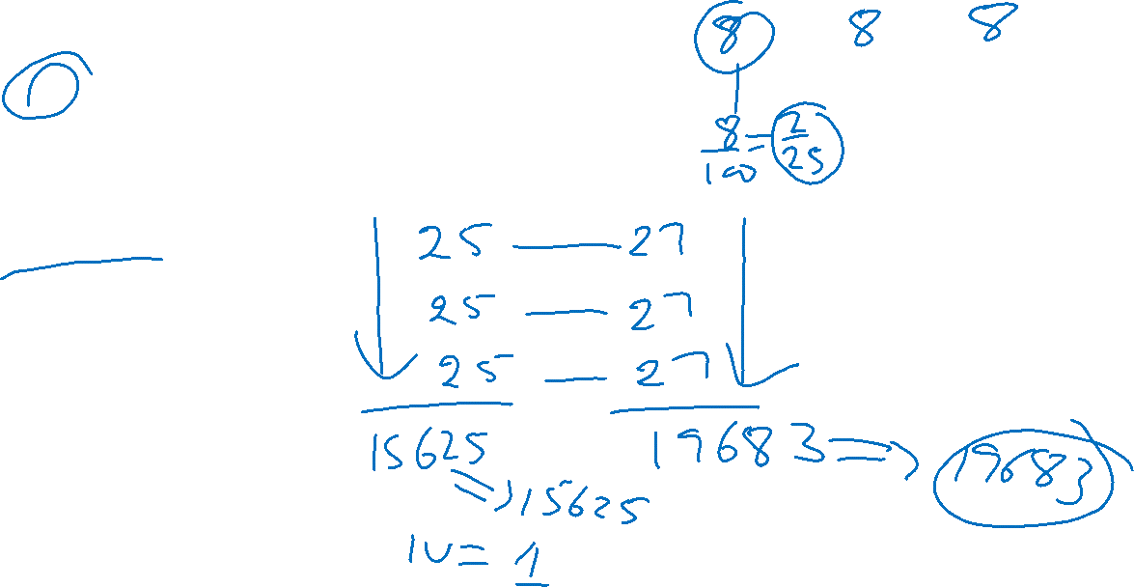
Percentage
Q 34. The population of a town is 15625. It increases 8 per cent annually. What will it be in 3 years?
16983
(2) 18693
(3) 19683
(4) 19638
(5) None of these

Slide 86
Percentage
Q 34. The population of a town is 15625. It increases 8 per cent annually. What will it be in 3 years?
16983
(2) 18693
(3) 19683
(4) 19638
(5) None of these

Slide 87
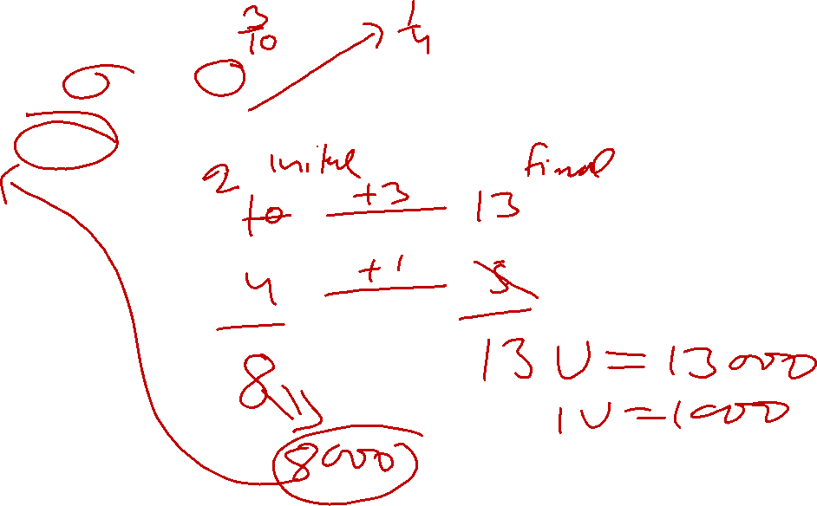
Percentage
Q 35. A man deposited 30% of the initial amount to his locker. And again after some time he deposited 25% of the increased amount. Now the amount becomes 13,000. How much was the initial amount?
8000
(2) 10000
(3) 12000
(4) 9000
(5) None of these

Slide 88
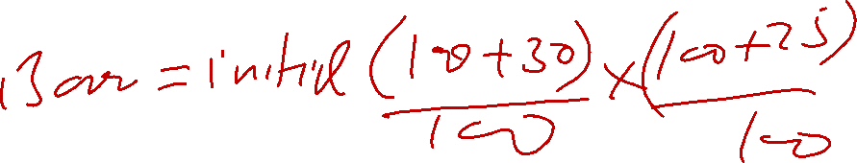
Percentage
Q 35. A man deposited 30% of the initial amount to his locker. And again after some time he deposited 25% of the increased amount. Now the amount becomes 13,000. How much was the initial amount?
(1) 8000
(2) 10000
(3) 12000
(4) 9000
(5) None of these

Slide 89
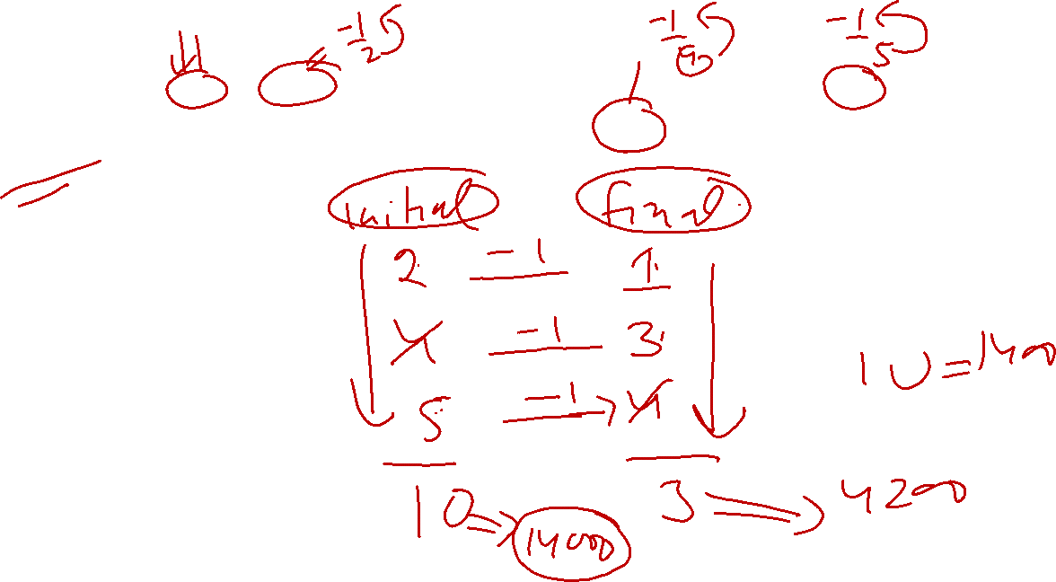
Percentage
Q 36. A man spends 50% of his income in board and lodging, 20% of the remainder in other personal necessities and 25% of the rest in charity, find his income, if he is left with 4200.
14000
(2) 8000
(3) 12000
(4) 18000
(5) None of these

Slide 90
Percentage
Q 36. A man spends 50% of his income in board and lodging, 20% of the remainder in other personal necessities and 25% of the rest in charity, find his income, if he is left with 4200.
(1) 14000
(2) 8000
(3) 12000
(4) 18000
(5) None of these

Slide 91
Percentage
Q 37. Two numbers are respectively 26% and 5% more than a third. What percentage is the first of the second?
120%
(2) 100%
(3) 80%
(4) 125%
(5) None of these

Slide 92
Percentage
Q 37. Two numbers are respectively 26% and 5% more than a third. What percentage is the first of the second?
(1) 120%
(2) 100%
(3) 80%
(4) 125%
(5) None of these

Slide 93
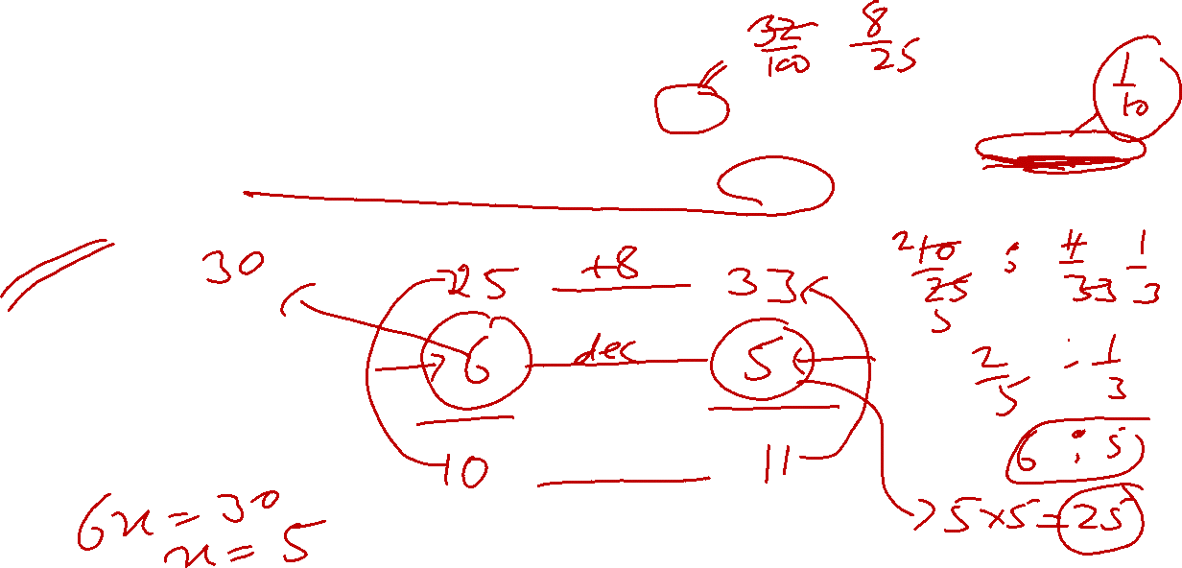
Percentage
Q 38. When the price of rice was increased by 32%, a family reduced its consumption in such a way that the expenditure on rice was only 10% more than before. If 30 kg were consumed per month before, find the new monthly consumption.
25 kg
(2) 24 kg
(3) 20 kg
(4) 18 kg
(5) None of these

Slide 94
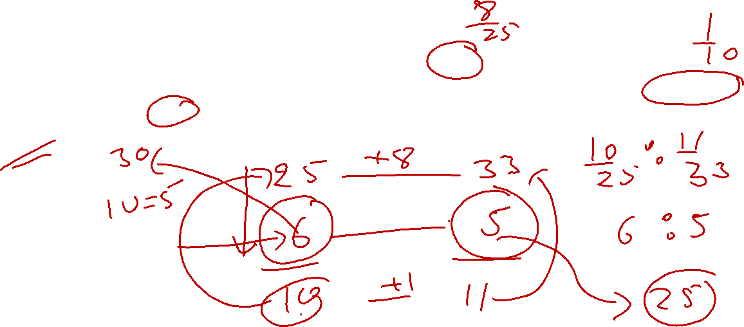
Percentage
Q 38. When the price of rice was increased by 32%, a family reduced its consumption in such a way that the expenditure on rice was only 10% more than before. If 30 kg were consumed per month before, find the new monthly consumption.
(1) 25 kg
(2) 24 kg
(3) 20 kg
(4) 18 kg
(5) None of these

Slide 95
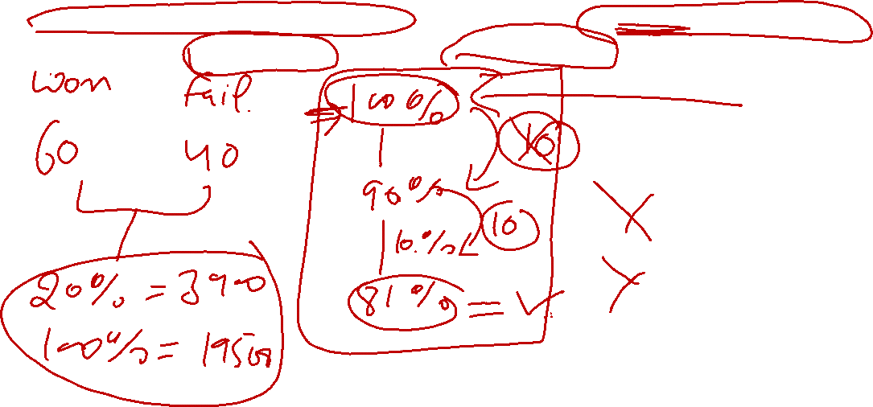
Percentage
Q 39. Two candidate participated in an election. 10% voter did not cast their votes and 10% votes were declared invalid. A candidate got 60% of total votes and won the election by 3900 votes. Find the total number of voters in voter list.
8100
(b) 10000
(c) 19500
(d) 9000

Slide 96
Percentage
Q 39. Two candidate participated in an election. 10% voter did not cast their votes and 10% votes were declared invalid. A candidate got 60% of total votes and won the election by 3900 votes. Find the total number of voters in voter list.
8100
(b) 10000
(c) 19500
(d) 9000

Slide 97
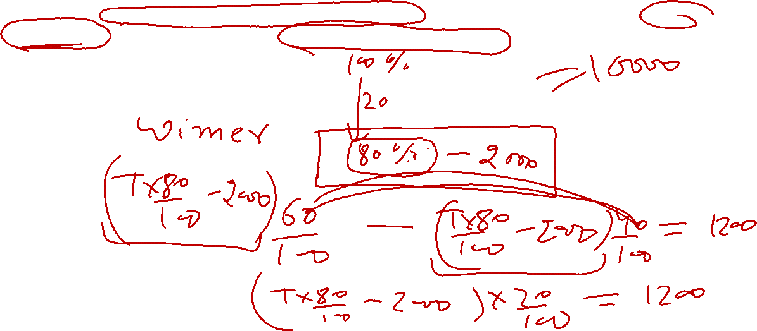
Percentage
Q 40. Two candidates participated in an election. 20% voters did not cast their votes and 2000 votes were declared invalid. Winner candidate got 60% of valid votes and got elected by 1200 number of votes. Find the total number of votes in voter list.
8750
(b) 7750
(c) 8000
(d) 10000

Slide 98
Percentage
Q 40. Two candidates participated in an election. 20% voters did not cast their votes and 2000 votes were declared invalid. Winner candidate got 60% of valid votes and got elected by 1200 number of votes. Find the total number of votes in voter list.
8750
(b) 7750
(c) 8000
(d) 10000

Slide 99
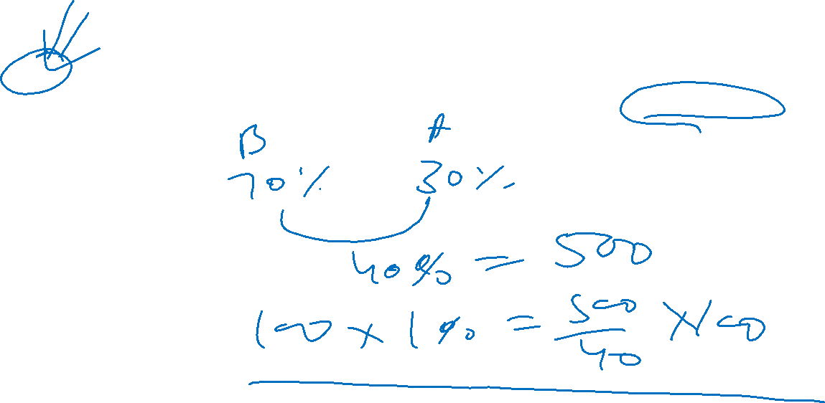
Percentage
Q 41. In an election two candidates participated A and B. A secured 30% of the total votes and lost the election by 500 votes. Find the total number of votes casted.
1050
(b) 1100
(c) 1250
(d) 1200

Slide 100
Percentage
Q 41. In an election two candidates participated A and B. A secured 30% of the total votes and lost the election by 500 votes. Find the total number of votes casted.
1050
(b) 1100
(c) 1250
(d) 1200

Slide 101

Percentage
Q 42. A company give 12% commission to his salesman on total sales and 1% bonus on the sales over ₹ 15000. If the salesman deposit ₹7650 after deducting his commission from total sales. Find total sales.
72000
(b) 70000
(c) 48000
(d) 60000

Slide 102
Percentage
Q 42. A company give 12% commission to his salesman on total sales and 1% bonus on the sales over ₹ 15000. If the salesman deposit ₹52,350 after deducting his commission from total sales. Find total sales.
72000
(b) 70000
(c) 48000
(d) 60000

Slide 103

Percentage
Q 43. A company give 10% commission to his salesman on total sales and 2.5% bonus on the sales over 10,000, If the salesman earns 2875. Find total sales
30000
(b) 28000
(c) 25000
(d) 29000

Slide 104
Percentage
Q 43. A company give 10% commission to his salesman on total sales and 2.5% bonus on the sales over 10,000, If the salesman earns 2875. Find total sales
30000
(b) 28000
(c) 25000
(d) 29000

Slide 105
Percentage
Q 44. A company give 5.5% commission to his salesman on total sales and 0.5% bonus on the sales over Rs.10000. If the salesman earns Rs.1990, Find total sale.
37000
(b) 35000
(c) 36000
(d) 34000

Slide 106
Percentage
Q 44. A company give 5.5% commission to his salesman on total sales and 0.5% bonus on the sales over Rs.10000. If the salesman earns Rs.1990, Find total sale.
37000
(b) 35000
(c) 36000
(d) 34000

Slide 107
THANK YOU

